Slide 1
Digital Portfolio
STUDENT NAME:MADHAVAN.S
REGISTER NO AND NMID: 212402377
DEPARTMENT: BCA
COLLEGE: A.M. Jain College

Slide 2
PROJECT TITLE
Portfolio to showcase
their skill

Slide 3


AGENDA
Problem Statement
Project Overview
End Users
Tools and Technologies
Portfolio design and Layout
Features and Functionality
Results and Screenshots
Conclusion
Github Link
3/21/2024 Annual Review

Slide 4

PROBLEM STATEMENT
Students need a modern digital portfolio to showcase their skills for placement.

Slide 5

PROJECT OVERVIEW
A digital portfolio helps present personal info, education, skills, and career goals in a structured way.

Slide 6

END USERS
Students, Recruiters, Companies

Slide 7

TOOLS AND TECHNOLOGIES
HTML, CSS, JavaScript, GitHub

Slide 8
POTFOLIO DESIGN AND LAYOUT
8

Slide 9
FEATURES AND FUNCTIONALITY
About section, Skills list, Contact info, Email & Phone integration

Slide 10
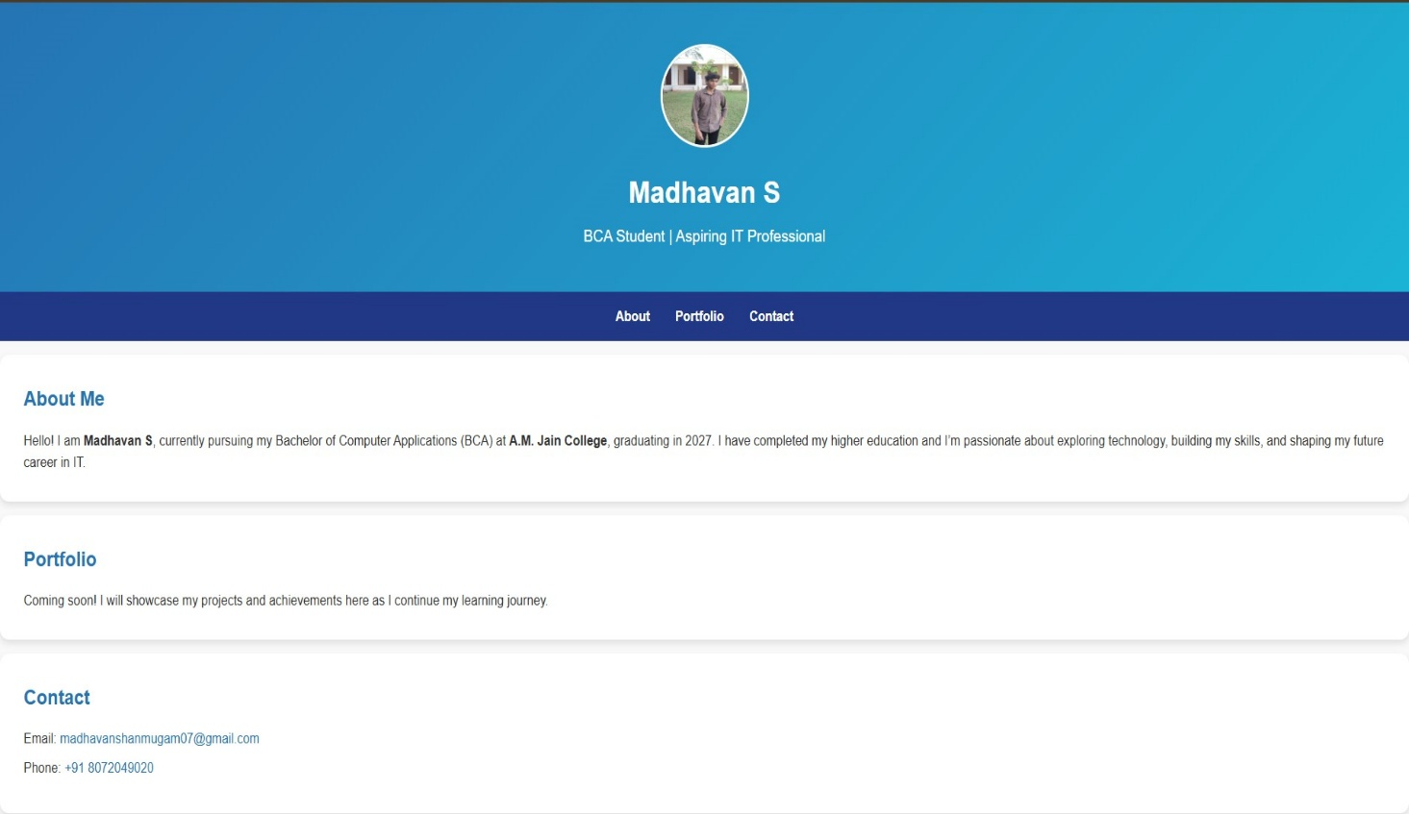

RESULTS AND SCREENSHOT https://24h003-13.github.io/protfoilo13/
3/21/2024 Annual Review
10

Slide 11
CONCLUSION
A portfolio improves chances of placement.
11

